Slide 1
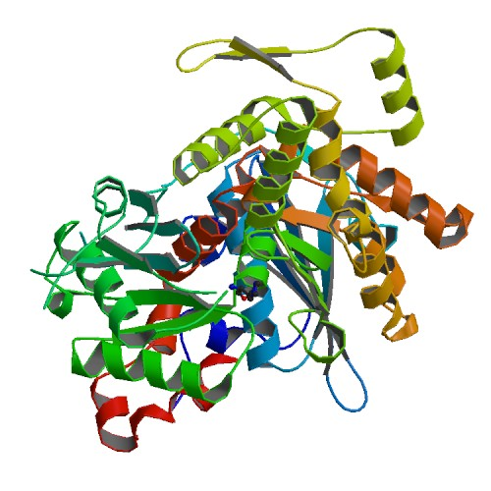
Biophysics
BT 301 26 July 2023
This Photo by Unknown Author is licensed under CC BY-SA

Slide 2
BT 301 Biophysics course assessment
Swami portions 50% [ MIDSEM 30 + surprise Quizzes 20]
Navin portions 50% [ Endsem + other assessments]

Slide 3
Some Topics in BIophysics
Structure of biomolecules / biomacromolecules
Techniques
Modelling and Simulation of Biomolecular systems

Slide 4

Protein and Nucleic acid structure

Slide 5
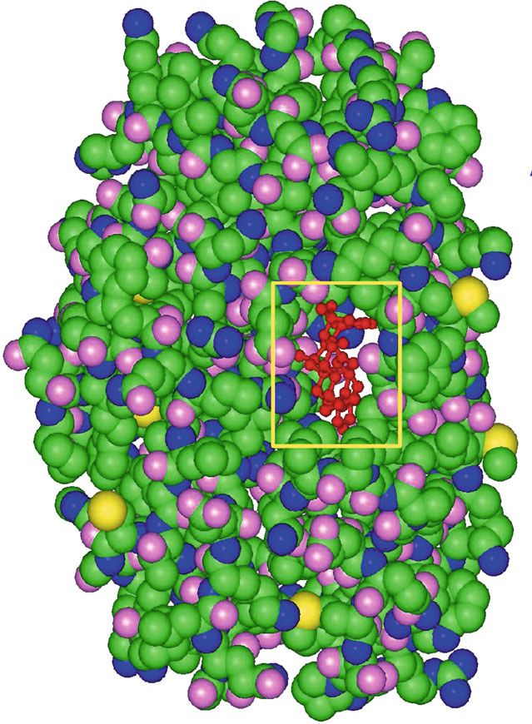
Protein Structure

Slide 6
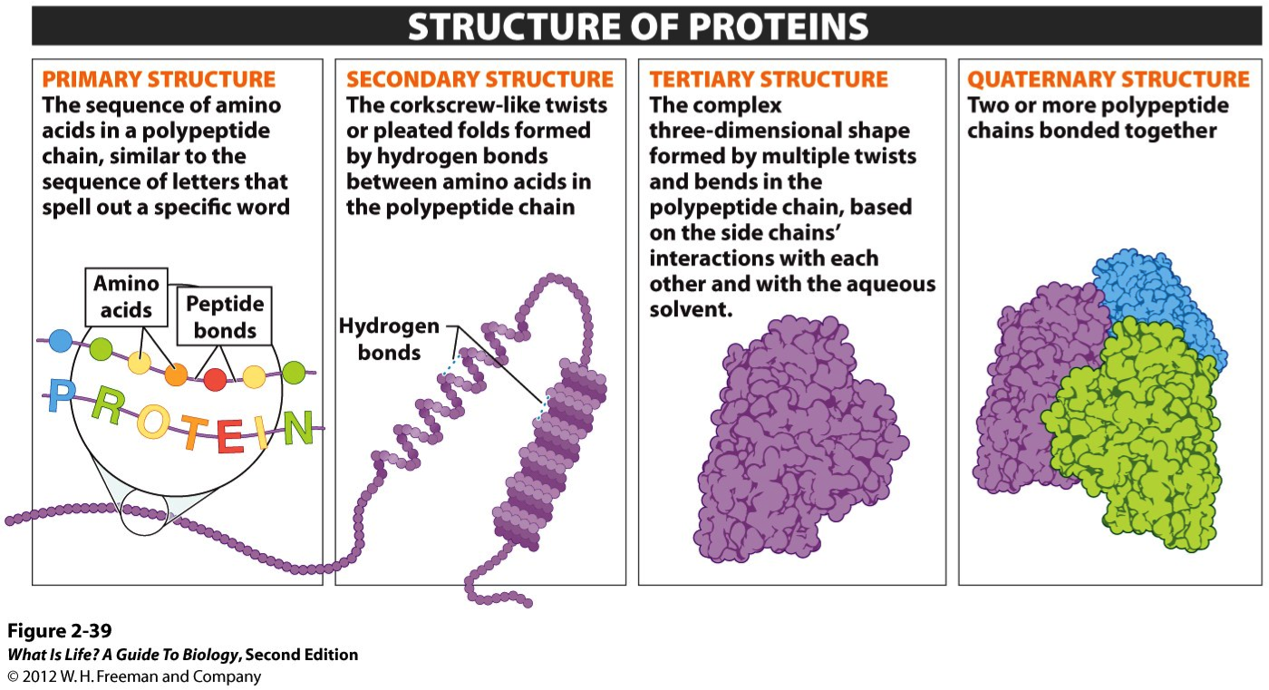
This Photo by Unknown Author is licensed under CC BY-SA

Slide 7
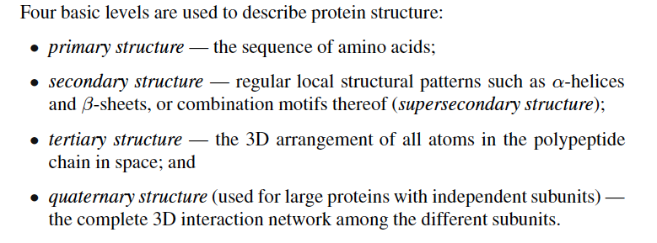
Protein Structure

Slide 8
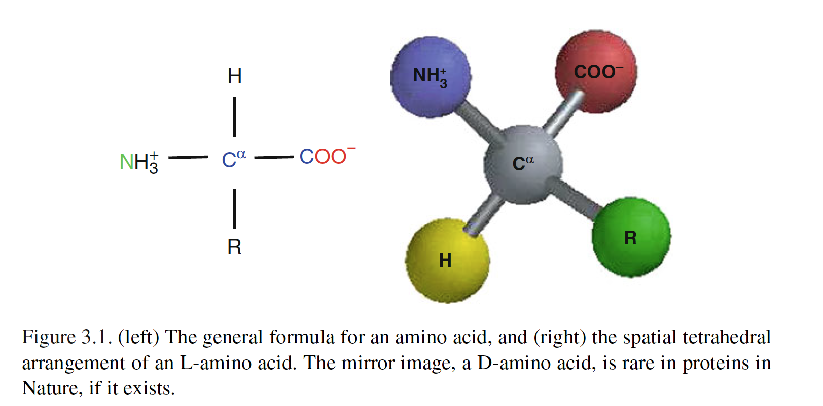
Protein Structure

Slide 9
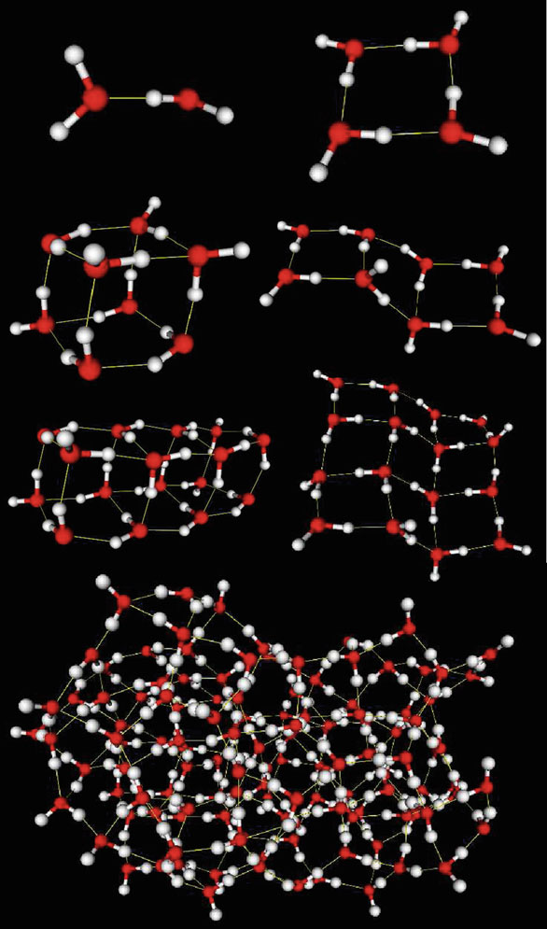
Hydrogen Bonding in water
Figure 3.2. Structures of water clusters of 2, 4, 8, 16, and 125 molecules as minimized with the CHARMM force field from initial coordinates computed in [1120]. Two geometries are shown for both the 8 and 16-molecule clusters; the lower energy structures (by roughly 4 and 6%, respectively) are associated with the more compact, cube-like shapes (left side in both cases). The tetrahedral structure of water is apparent in the inner molecules of the larger systems, where each molecule is hydrogen bonded to four others.

Slide 10
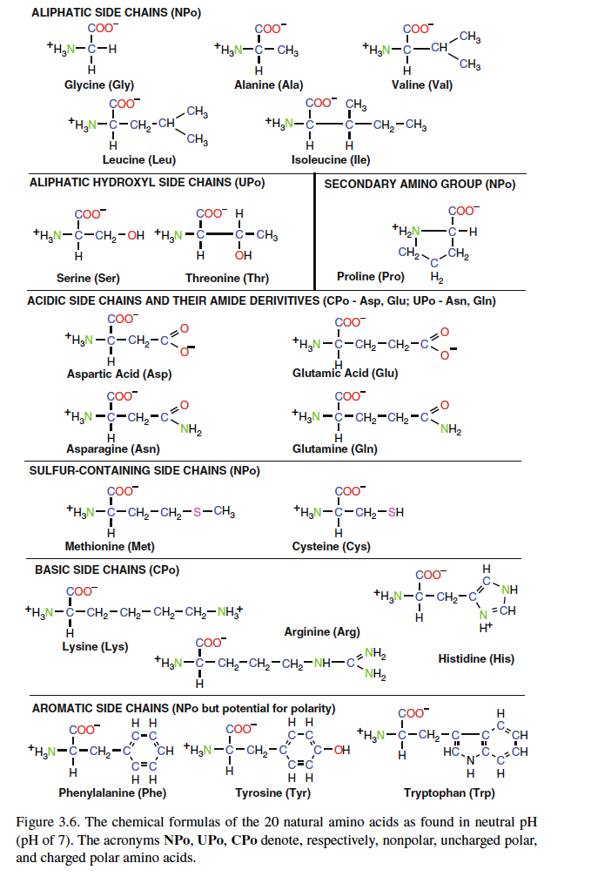
Protein Structure
AMINO ACIDS

Slide 11
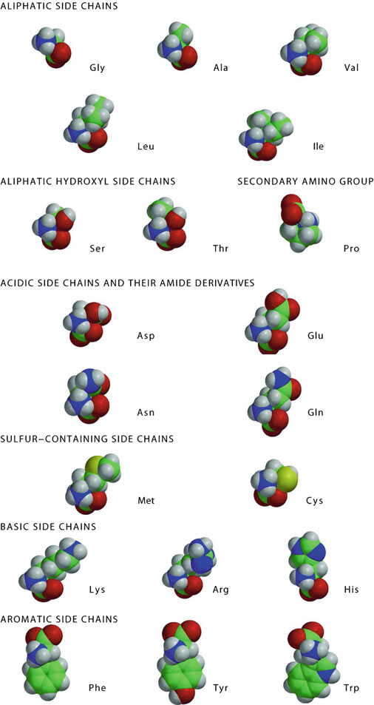
Protein Structure
Space filling models of 20 amino acids

Slide 12
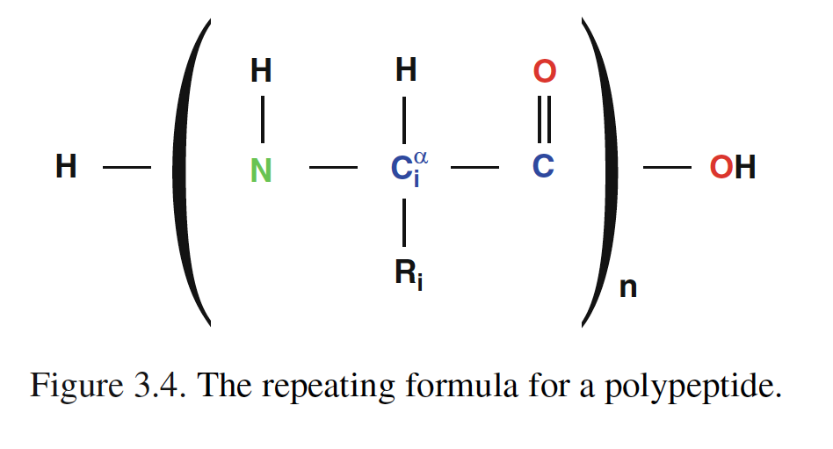
Protein Structure

Slide 13
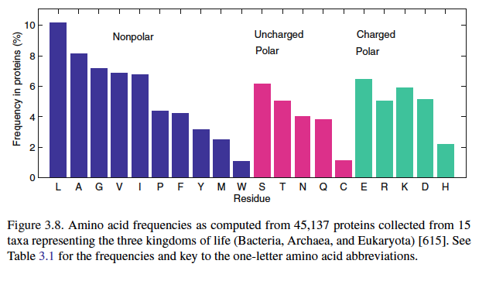
Protein Structure

Slide 14
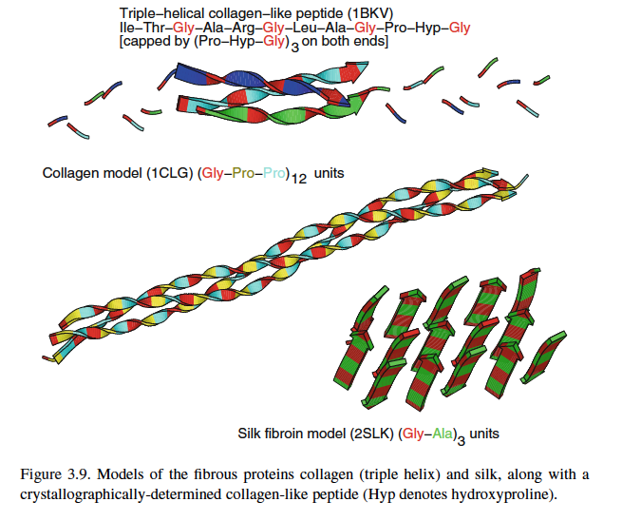
Protein Structure

Slide 15
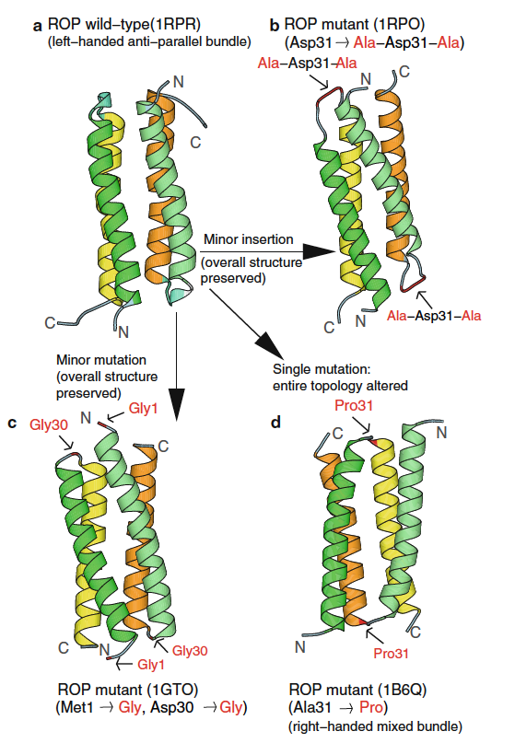
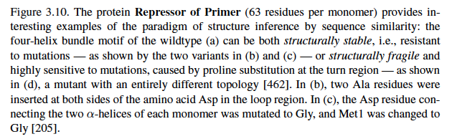
Protein Structure

Slide 16
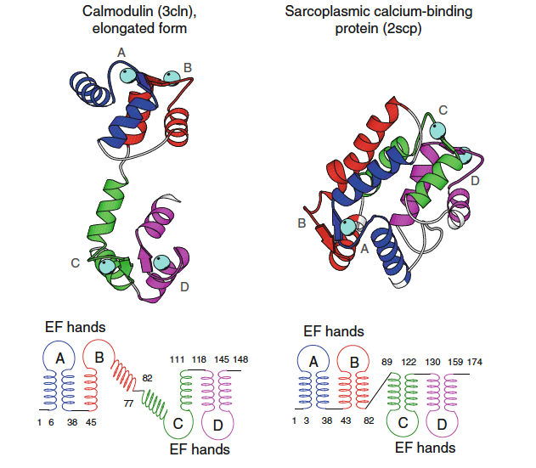
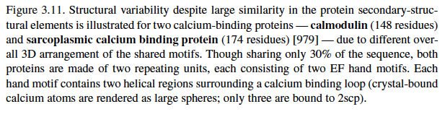
Protein Structure

Slide 17
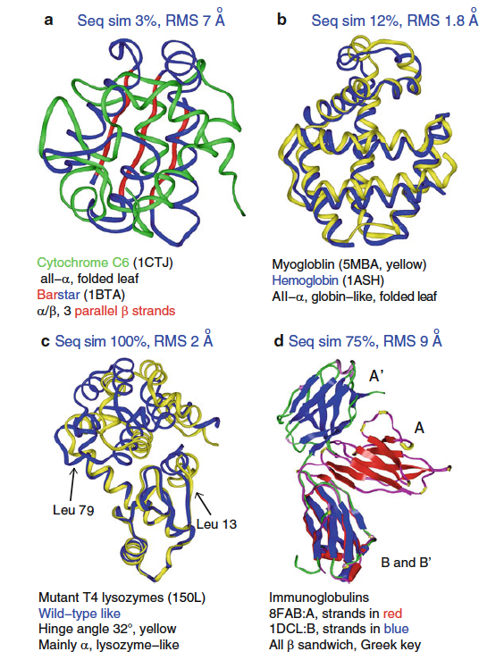
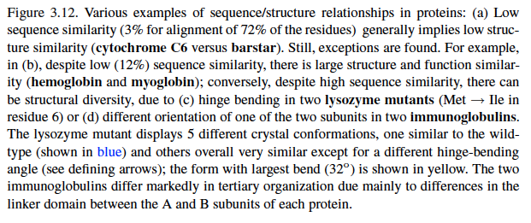
Protein Structure

Slide 18
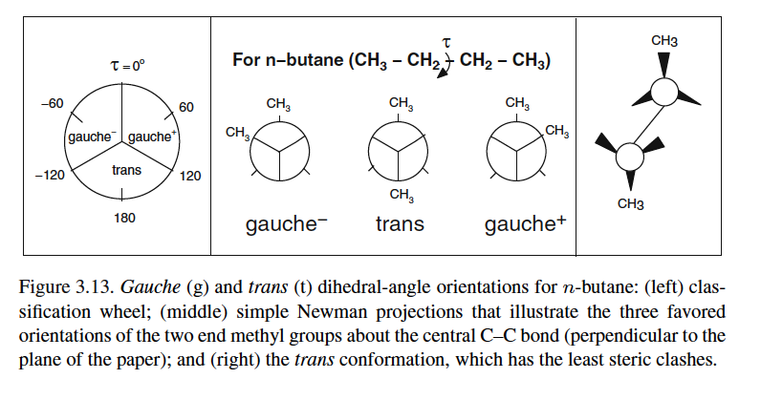
Protein Structure

Slide 19
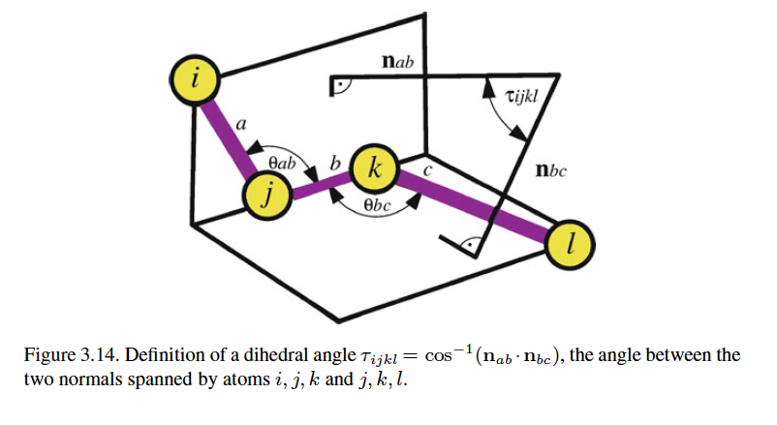
Protein Structure

Slide 20
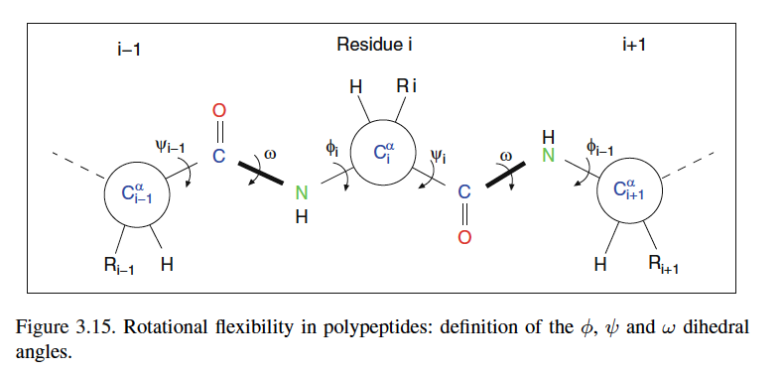
Protein Structure

Slide 21
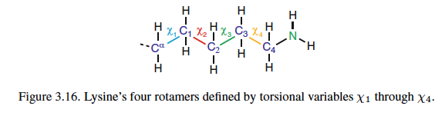
Protein Structure

Slide 22
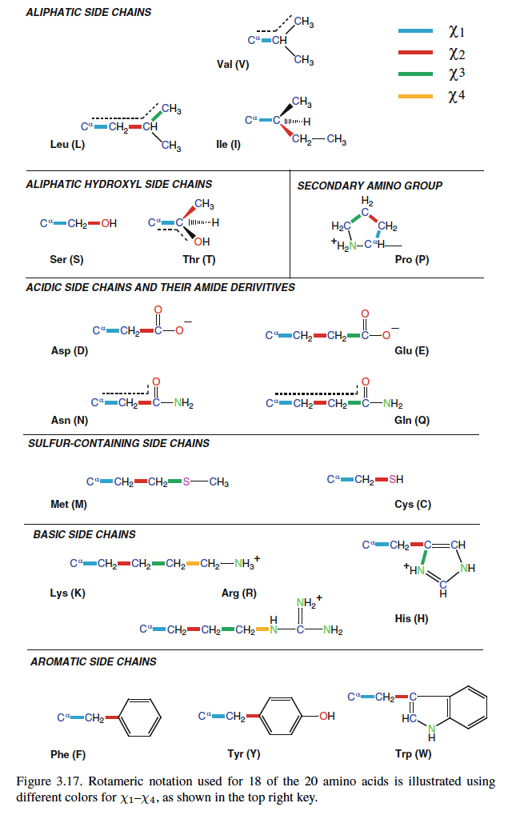
Protein Structure
Rotamer Notation

Slide 23
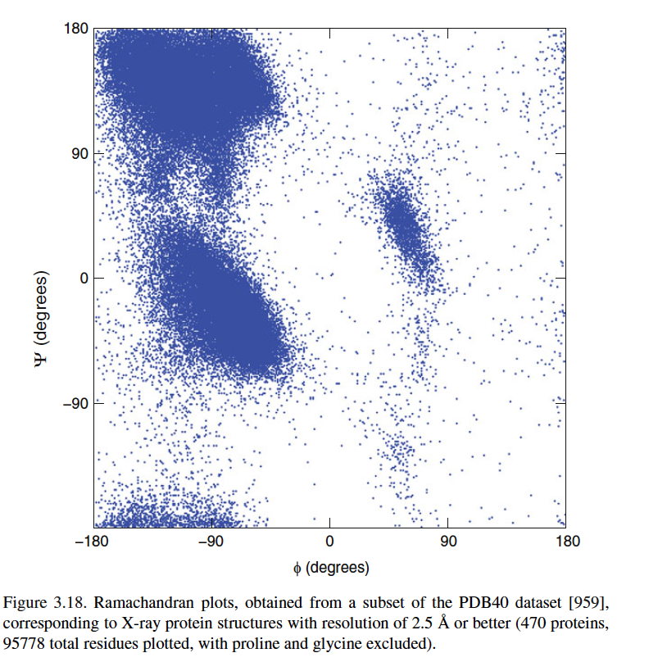
Protein Structure
Ramachandran Plot

Slide 24
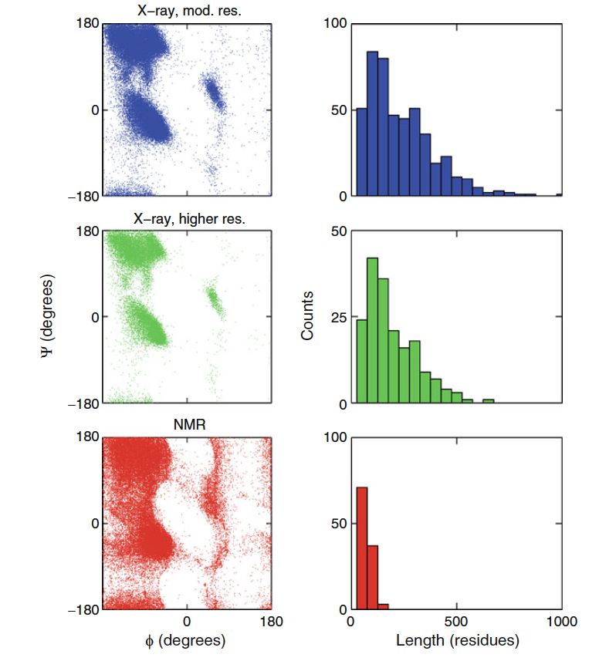
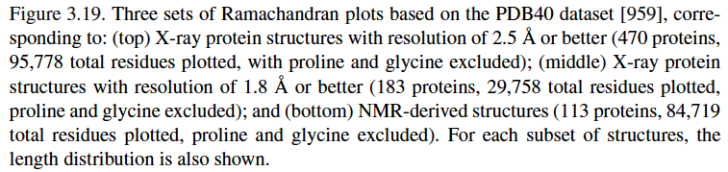
Protein Structure

Slide 25
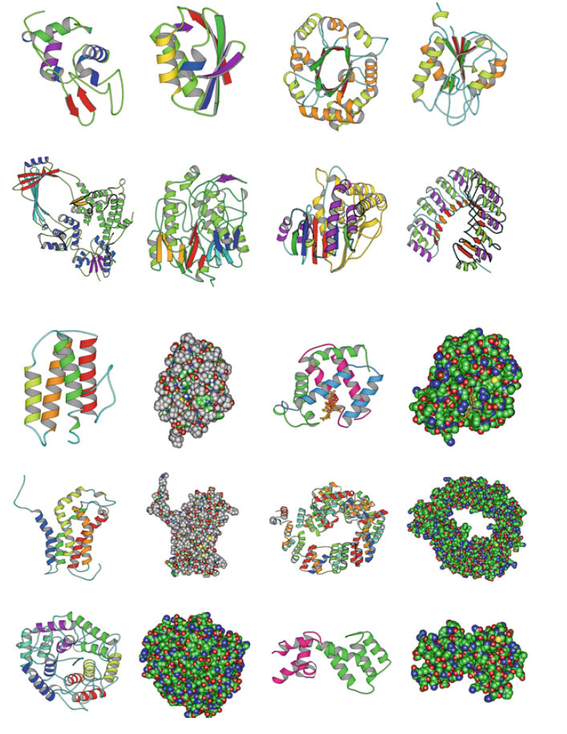
Protein Structure

Slide 26
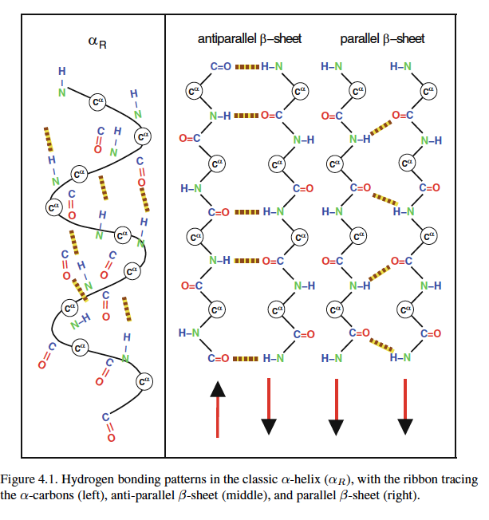
Protein Structure

Slide 27
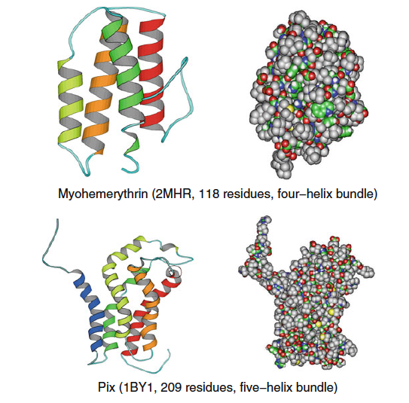
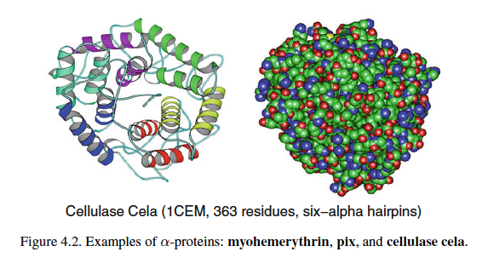
Protein Structure

Slide 28
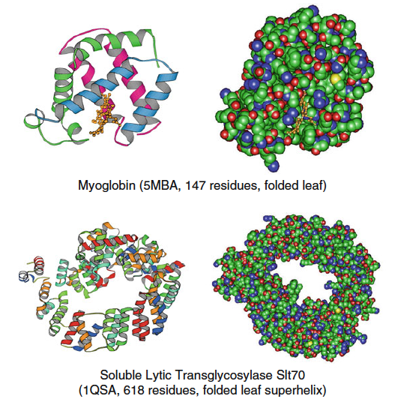
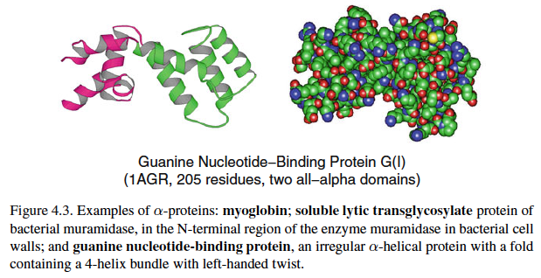
Protein Structure

Slide 29
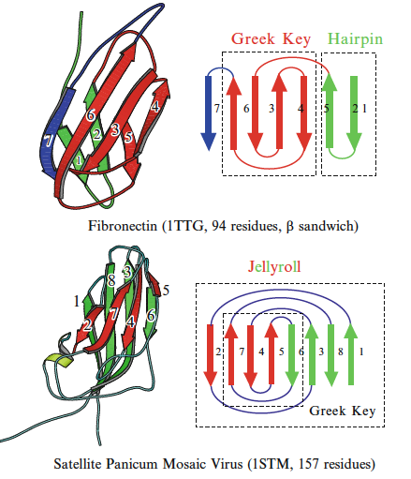
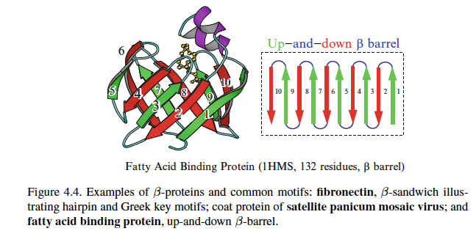
Protein Structure

Slide 30
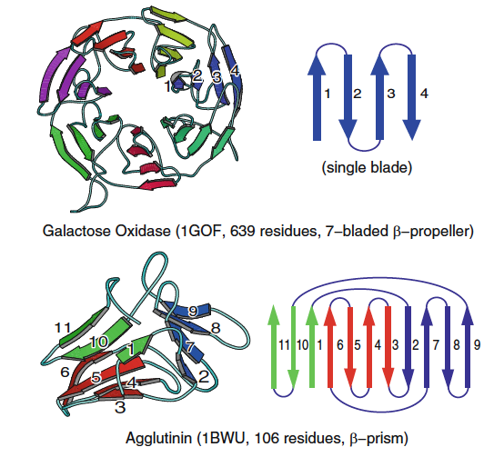
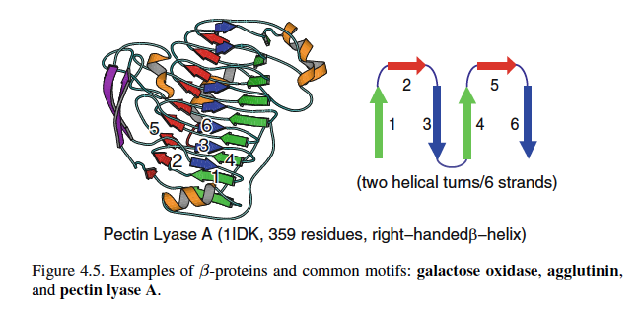
Protein Structure

Slide 31
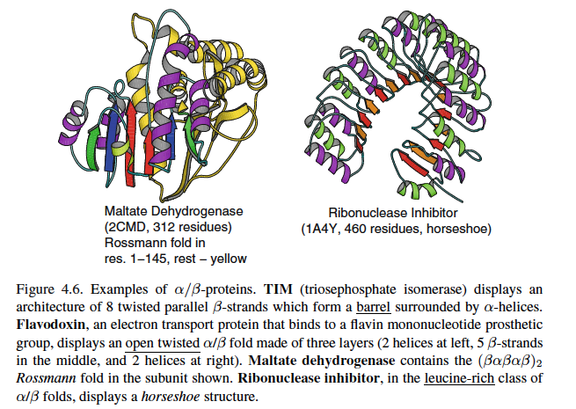
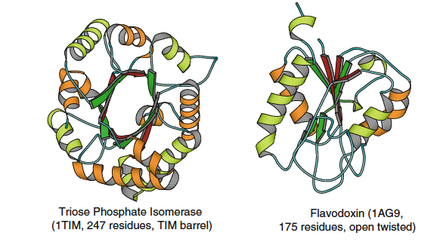
Protein Structure

Slide 32
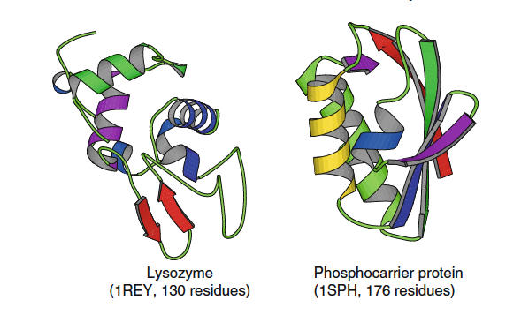
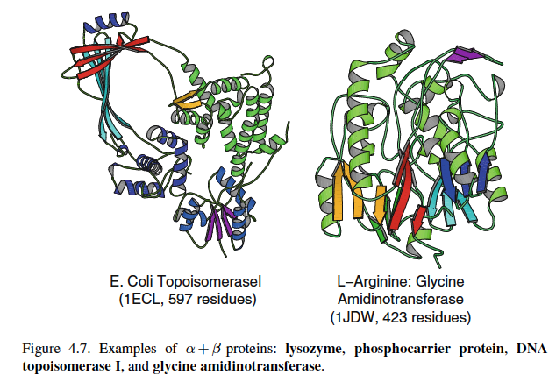
Protein Structure

Slide 33
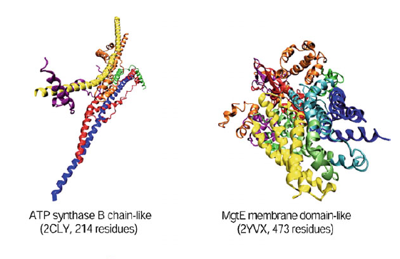
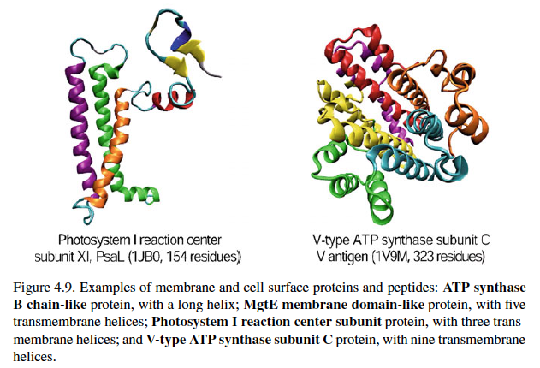
Protein Structure

Slide 34
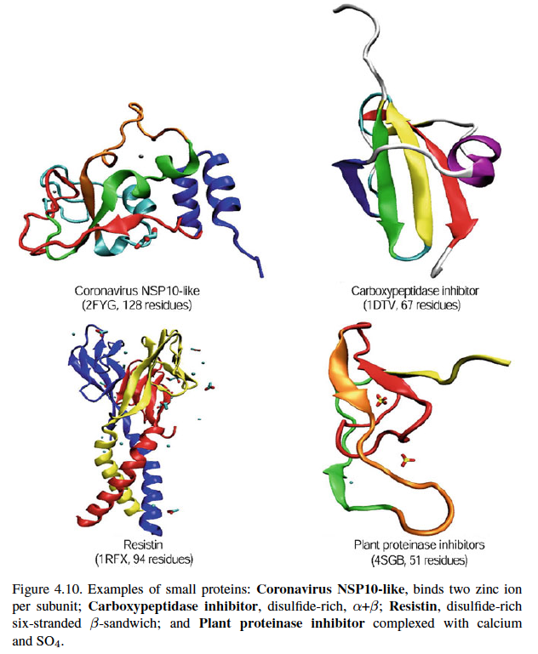
Protein Structure

Slide 35
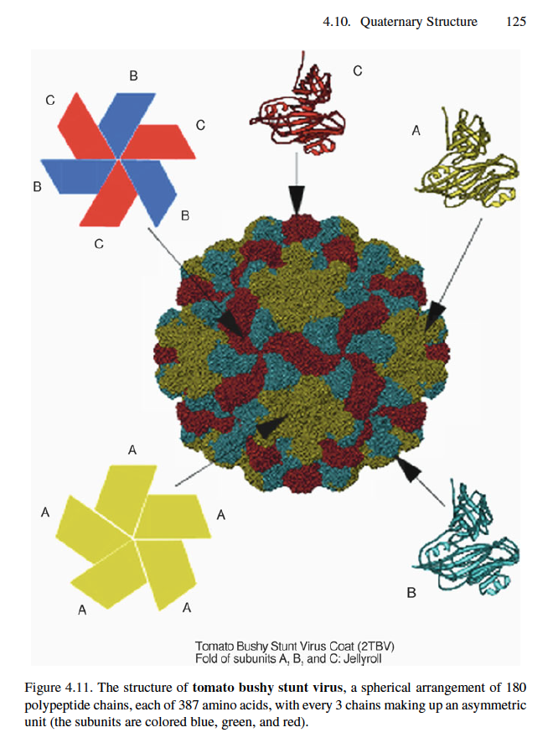
Protein Structure

Slide 36
Protein Structure

Slide 37
Protein Structure

